Slide 1
True or False?
Bullying is something that only happens once

Slide 4
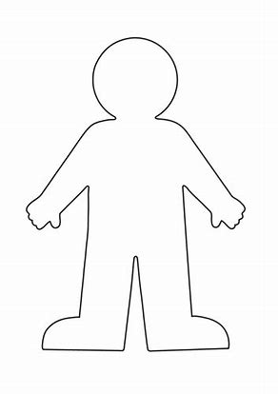
What does bullying look like? What does bullying feel like?
Discussion

Slide 5
Make a noise about bullying!
Make a noise! Exhibition in the hall
Design a poster to show the message:
You can draw and colour your own poster of the message.
Make a three-picture storyboard showing a situation, what needs to be done and the message.
Make a model of a bullying situation and its resolution with labels using plasticine.
Take photos and use ICT to make lettered banners to go with the photos.
Make a collage of the message.
Write a rap to convey the message and/ or a dance-record this on a video.
Click the image to re-watch the video so that you are clear on the message.

Slide 6
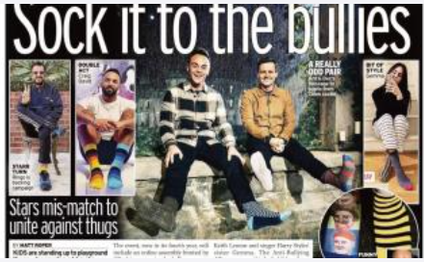
Why are these celebs wearing odd socks?
What messages do they want people to listen to?

Slide 7
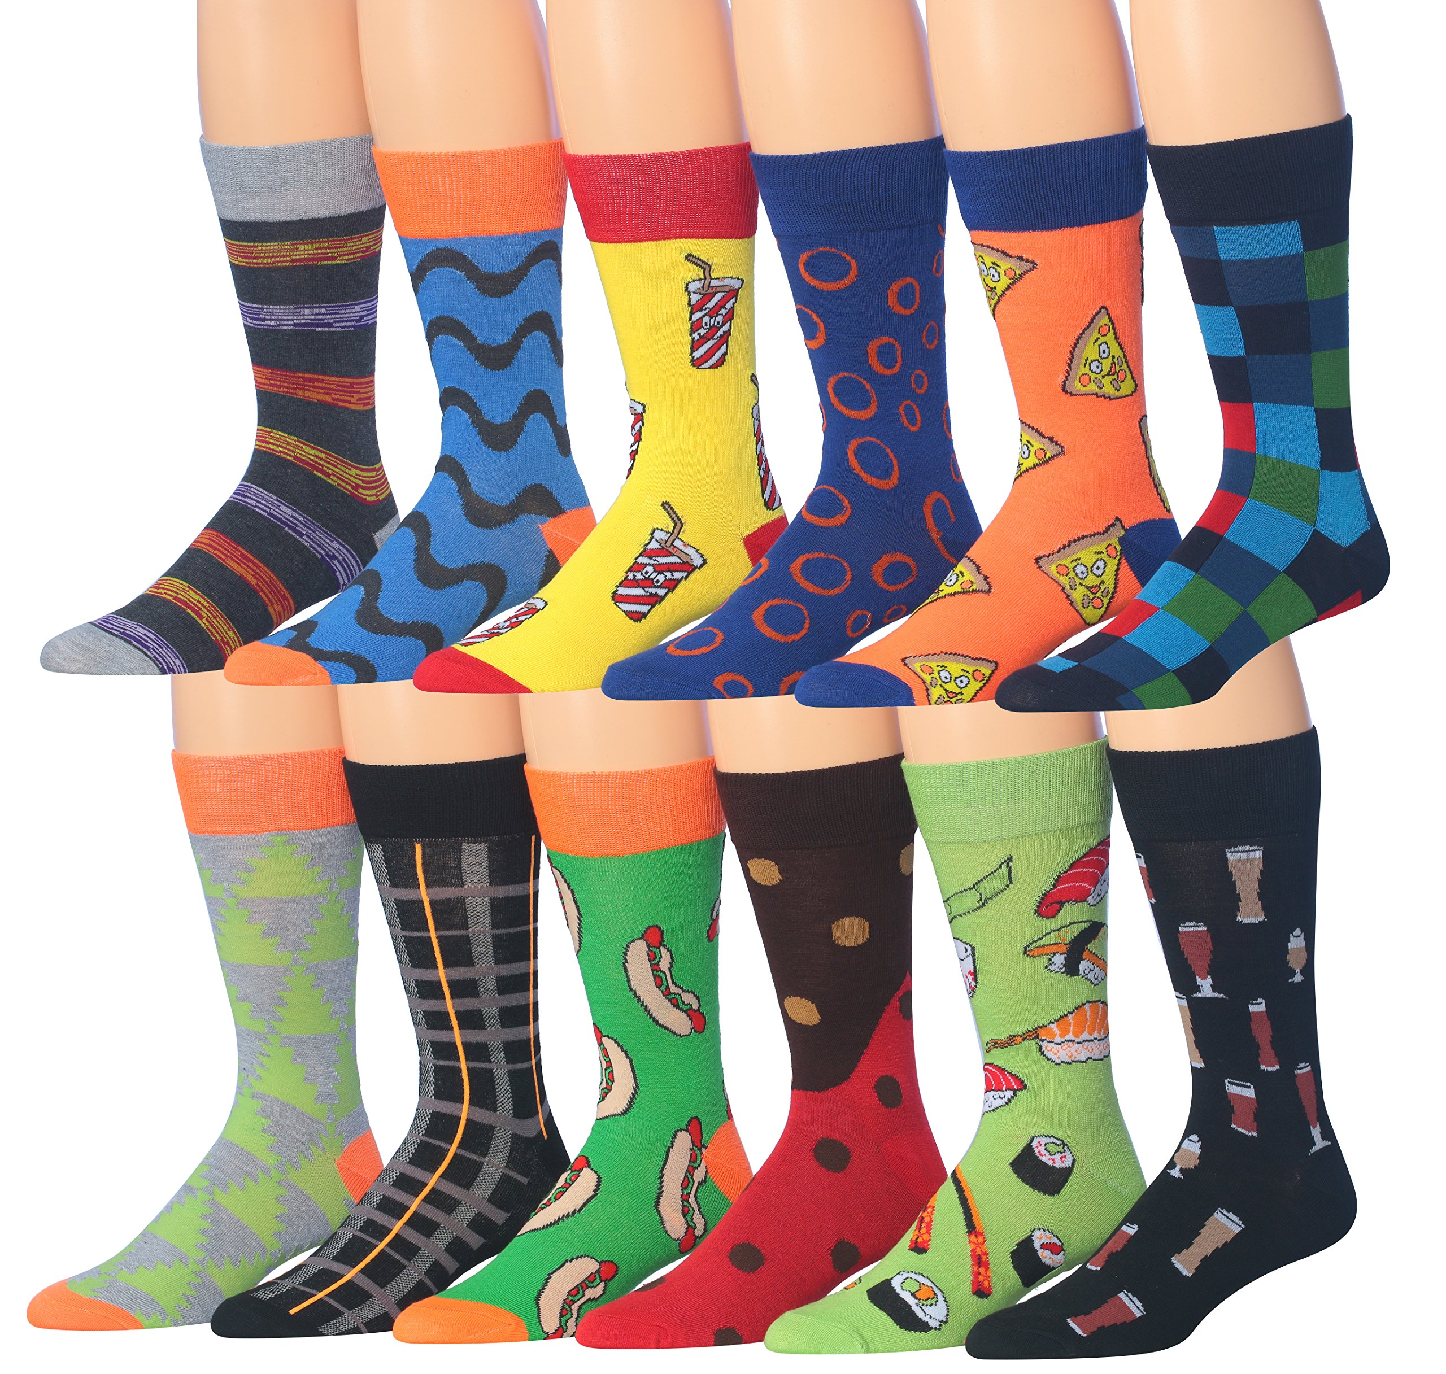
We are all different and unique!
Design a pair of socks. On one sock show what makes you unique and different.
On the other, put a design for the anti-bullying message: make some noise!

